Slide 1
Wintersemester 2017
Network Motif:
Simulation of Feed-Forward Loop
Sina Bayer, Lisa De Mont
Supervisor: Björn Goldenbogen
Humboldt-Universität zu Berlin Institut für Biologie Theoretische Biophysik

Slide 2
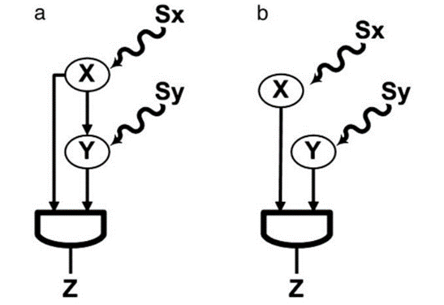
FFL vs. Simple regulation
8 types of ffl

Slide 3
Coherent vs. Incoherent
Graphen 8 types of indirect path

Slide 4
Incoherent Type 1 and 4 AND Sy=1 vs. Sy=0

Slide 5
Basal Y activity

Slide 6
AND vs. OR
graphen

Slide 7
Occurence in E. coli and Yeast
Vorund nachteile vom paper
Allgemeine Aussage
Andere Motive network

Slide 9
Thank you for your attention! Also special thanks to our supervisors.

Slide 10
Sources
‘’Structure and function of the feed-forward loop network motif’’
S. Mangan and U. Alon†
Departments of Molecular Cell Biology and Physics of Complex Systems, Weizmann Institute of Science, Rehovot 76100, Israel

